Slide 1
Options Trading Competition
Week 2

Slide 2
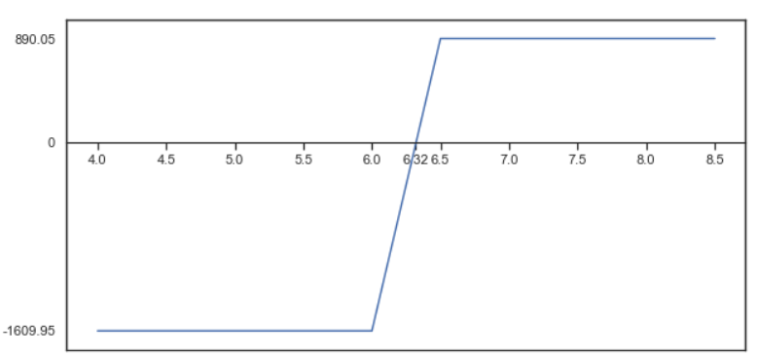
What Happened Last week:
Executed a Bull Call Spread on MEG.TO for 50 options
Upper strike price of $6.50
Lower strike price of $6.00
Current MEG price: $5.97
Created an Excel spreadsheet for calculating critical numbers for strategies

Slide 3
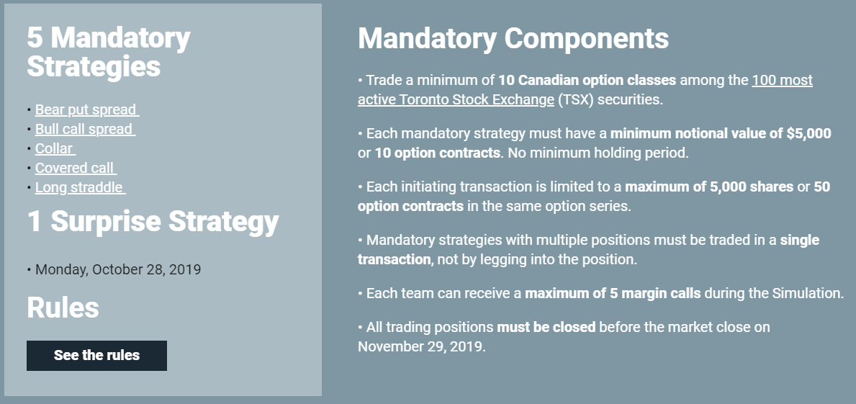
Refresher on the competition
Note: The options on this simulator are European style options
Last week we discussed mandatory strategies, but we ignored the rest.
Only 50 options contracts per trade
What does this mean for us?

Slide 4
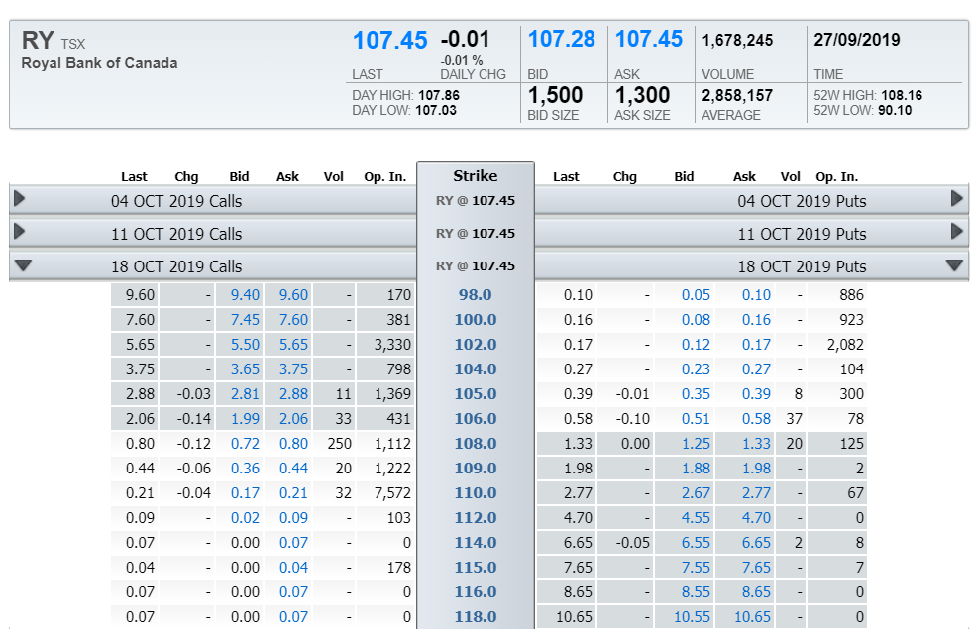
Refresher on the TMX Options Chain

Slide 5
Spreads
The spread is the difference between the BID and the ASK price
The ASK price is what people who are looking to sell are willing to sell for
The BID price is what people who are looking to buy are willing to buy for
Higher volume and liquidity is going to lead to lower spread
Why is this important and what does it mean for us?
In order to close out of a trade, you need to do the opposite of what you did to open. If you bought to open, you need to sell to close. Which means the difference in BID/ASK is important.
Ex. If the BID/ASK on MEG.TO is $5.97/$6.02, if you BUY 100 shares, you already down $5
Options even more amplified!!!

Slide 6
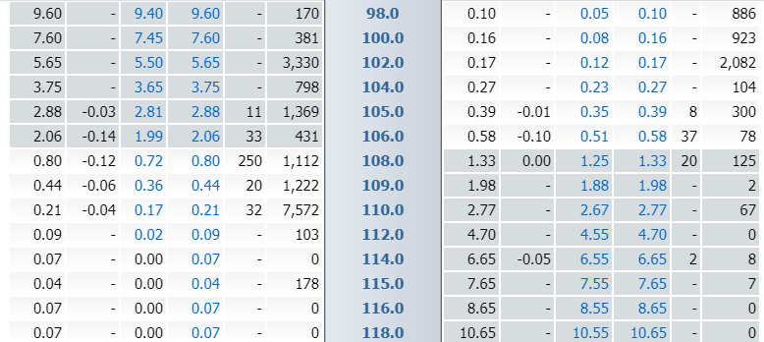
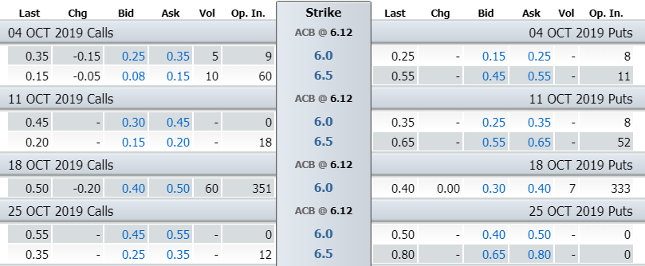
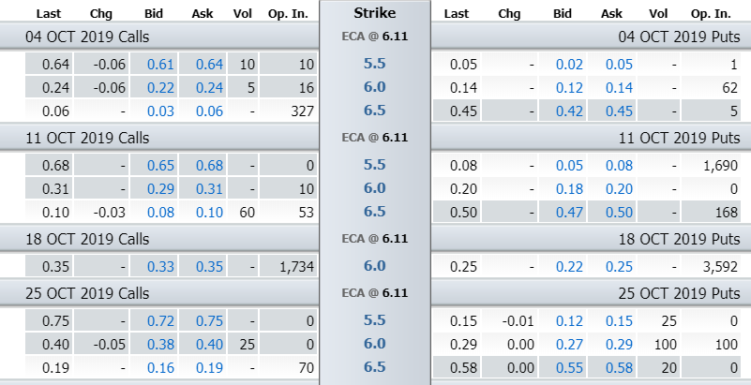
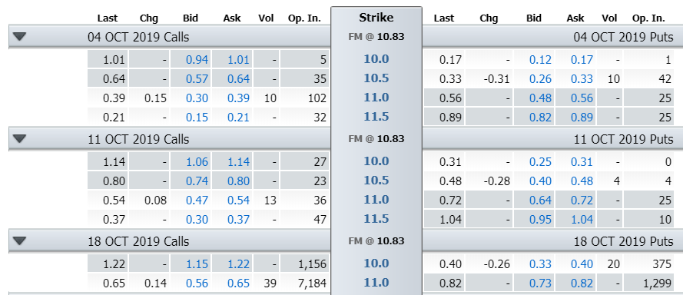
Spreads: TMX Options
Royal Bank:
ACB:
ECA:
FM:
Notes:
-We are going to have to focus on holding options positions until expiry.

Slide 8
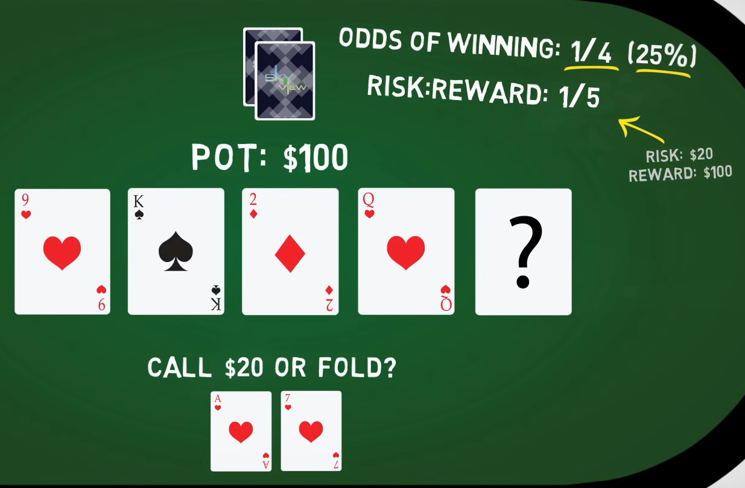
Review of probability theory

Slide 9
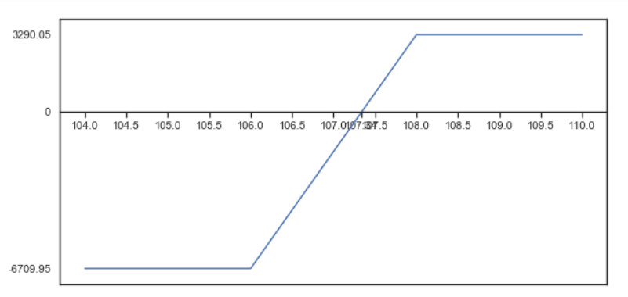
How this applies to us:
Let us assume that the direction that any given stock goes in a day is purely a 50-50 chance
Our risk/reward here is 0.49, the break-even is $107.34, and the current market price is 107.45
Is this trade worth it? How do the probabilities work out?

Slide 10
Review of Options pricing
Two key factors in the premium of an option:
Implied Volatility
A metric that captures the market’s view of the likelihood of changes in a given security’s price. Higher implied volatility means that investors expect a bigger move in the market. Higher implied volatility means options will have a higher premium.
Ex. 20% IV on a $50 stock means that 1 standard deviation is expected to be $40-$60
The standard deviation is expected over the time length of the contract (see Black-Scholes)
Time Decay
Time decay is a measure of the rate of decline in the value of an options contract due to the passage of time. Options get less valuable as time goes on

Slide 11
Historical volatility vs implied volatility
Historical volatility is the actual volatility (stdev) of a stock
IV Percentile is the percentage number of days over the past one year the IVs are under the current IV
If IV is 25%, that may be high, but if IV is 25% everyday, it is not that extraordinary
Implied volatility is pretty much always higher than the historical volatility
ex. For the DJI, the IV vs HV was found to have a 6.25% difference, IV was 12% HV was 6%
In other words, markets always overexpecting the volatility of a stock
What can we do with this information?

Slide 12
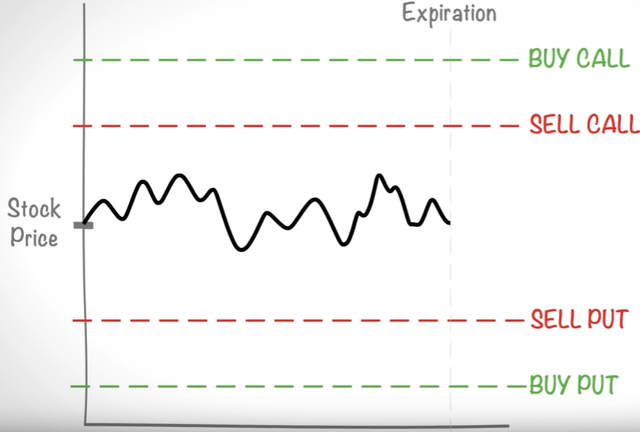
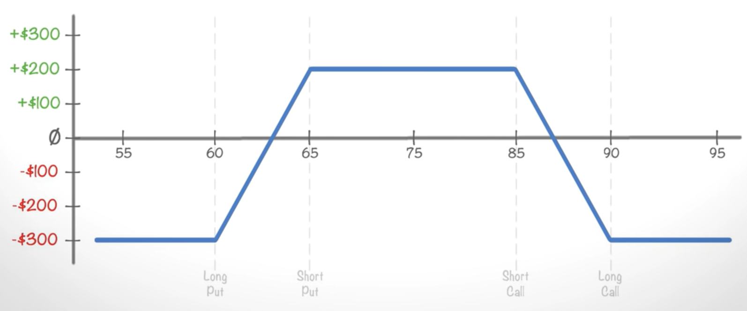
The Iron Condor Strategy
The Iron Condor is an options trading strategy consisting of four legs
Selling an OTM CALL, for the premium
Buying a further OTM CALL, for protection in case the price goes above the sold OTM CALL
Selling an OTM PUT, for the premium
Buying a further OTM PUT, for protection in case the price goes below the sold OTM PUT
Essentially what you want with this strategy is for the price to stay within a certain range, i.e between the sold options’ strike prices

Slide 13
Key Takeaways:
Probability based trading – If the market is 50/50, is this trade favoured?
Let’s start executing more trades
More neutral trades where we are not taking a direction one way or another
Betting that the price will stay within a certain range
Higher implied volatility leading to overpriced options is an inefficiency in the market, we can consistently make money by exploiting this inefficiency

